Slide 1
Marine Corps System Command
Contracts
Barbara Hawes
Kathleen Keys
Brittany Olin
Jennifer Westerholm
Defense Acquisition Professionals
Serving on the frontlines of industry and innovation!
Equipping Marines serving on the frontlines!
DISTRIBUTION STATEMENT A. Approved for public release. Distribution is unlimited.

Slide 2
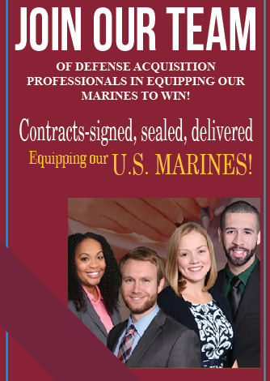
Event Agenda
Brief Presentation
Panel Members Presentations
Q&A

Slide 3
About U.S. Marine Corps
Systems Command (MCSC)
MCSC puts effective gear in the hands of Marines when needed. We understand their operational necessity, and we deliver materiel solutions at the speed of relevance. We excel in this solemn and compelling responsibility—to deliver advantage to U.S. Marines against any adversary every time, in any clime and place
Our Mission : To serve as the Department of the Navy's systems command for Marine Corps ground weapon and information technology system programs in order to equip and sustain Marine forces with full-spectrum, current and future expeditionary and crisis response capability
Our Workforce: 2,415 453 Military (19%) /1962 Civilian (81%)
Our Locations: Our Headquarters is located on Marine Corps Base Quantico, VA. We enjoy a campus-like setting location on the Potomac, away from I-95 congestion and within walking distance from the VRE
We also have satellite offices in Stafford, VA; Orlando, FL, & San Diego, CA
Notes:
Contracting professionals are needed throughout the U.S. and overseas, where they are employed by essentially all government agencies and programs, including the branches of the armed forces

Slide 4
Contracting Career
Civilian role within the acquisition workforce responsible for procuring goods and services such as information technology, weapons, military vehicles, to cutting-edge research, supplies and services.
Contracting Officers (COs)
Are appointed and given delegation of special authority
Negotiate on behalf of the United States Government.
Obligate and bind the U.S. Federal Government to a contract –
Are the only individuals authorized to execute, modify, or terminate a contract.
As a CO, you will be responsible for selecting vendors and overseeing that contractual agreements are legally compliant, appropriately funded, fair and impartial. It will also be your job to ensure that contracts are providing maximum value and that taxpayers' money is being responsibly spent.
Notes:
MCSC contracting roles, such as contract officer and contract specialist, can be challenging and rewarding careers.
However, students and emerging professionals may not be familiar with the primary responsibilities, job requirements or internship opportunities related to this field

Slide 5
You will interface with vendors, view and assess various products and services offered, or under consideration, and gain relative hands-on experience
.
As a Contracting Professional you will provide
critical support to the USMC !!
.
Notes:
The Marine Corps seeks candidates with strong analytical and communication skills who possess a high degree of integrity and morals. As a Contracting professional, you are the only Government official authorized to obligate money for the Marine Corps. YOU purchase weapon systems, supplies and service in support of the US DoD worth millions of dollars and have the ability to select which company will get Marine Corps business. YOU work with small and large businesses, high level officials of the U.S. Government and Foreign Governments. YOU negotiate major deals with Fortune 500 companies and YOU are the “Business Advisor” of Marine Commanders and the Secretary of the Navy.
Because of your essential role and responsibility, you must be able to write well, be confident in speaking with CEO’s, and Members of Congress. You may be called upon to defend your position! You will need good, solid math skills to calculate why one contractor’s price is more cost effective than another’s. The single most important question that you will have to answer for every deal is “Was this the best value”? To answer this question, you need good math and statistical application skills.
To be successful in a contracting career, one should possess strong communication skills, analytical abilities, and a penchant for problem-solving which will be important in cost analysis, contract negotiation and other administrative duties

Slide 6
Salary & Benefits
Salary range is between $57,000 and $170,000 per year
Health Care & Life Insurance
Savings/Retirement
10 Paid Holidays
Annual and Sick leave
Additional Family & Medical Leave
Flexible Work Schedules/Telework Opportunities
Education, Training & Professional Development
Travel
Tuition Assistance Opportunities

Slide 7
Opportunities
Full Time Work for Recent Graduates (Contracting Development Programs)
Average Starting Salary $49K. Upon successful completion average salary targets are $86K-$102K
Established Career Track for continued Promotion/Advancement over a 2 -3 year term. Naval Acquisition Career Development Program https://www.secnav.navy.mil/rda/workforce/pages/nadp.aspx
Part Time or Full Time Work for Students (Student Intern/Trainee)
Average Salary is $40K for Full Time (National Capital Region)
Flexible Hours –While Attending School
Navy/Marine Corps Pathways https://www.secnav.navy.mil/donhr/How-To-Apply/Students/Pages/Default.aspx
Full Time Summer Work for Students
Average Salary is $11-$22 an hour
Look out for the Annual Call for Application in Sept/Oct
DoD College Acquisition Internship Program (DCAIP) https://www.dcaip.app/

Slide 8
Position Requirements
Summer Hire and Student Trainee: Must be a student in good standing working toward completion of a Degree
Entry Level Developmental Positons: Applicants must have, or be within 6 months of being granted, a Baccalaureate Degree from an accredited institution of higher learning. It may be helpful to have at least 24 credit hours in business, economics, finance, computer science, contracts, law, statistics, organization and management or related business specific courses.
  Some positions require a GPA of 3.0 or higher
  US citizenship and security clearance

Slide 9

How to Apply
Navy Marine Corps How to Apply for Student Intern Programs
https://www.secnav.navy.mil/donhr/How-To-Apply/Students/Pages/Default.aspx
  Step 1: Write a Resume
  Step 2: Register with USAJOBS
  Step 3: Find Job Openings
  Step 4: Apply
  Step 5: After You Apply
  Step 6: Interview
  Step 7: Offer of Employment
Notes:
Step 1: Write a Resume https://www.secnav.navy.mil/donhr/How-To-Apply/Application-Steps/Pages/Write-a-Resume.aspx
Step 2: Register with USAJOBS https://www.secnav.navy.mil/donhr/How-To-Apply/Application-Steps/Pages/Register-with-USAJOBS.aspx
Step 3: Find Job Openings https://www.secnav.navy.mil/donhr/How-To-Apply/Application-Steps/Pages/Find-Job-Openings.aspx
Step 4: Apply https://www.secnav.navy.mil/donhr/How-To-Apply/Application-Steps/Pages/Apply.aspx
Step 5: After You Apply https://www.secnav.navy.mil/donhr/How-To-Apply/Application-Steps/Pages/After-You-Apply.aspx
Step 6: Interview https://www.secnav.navy.mil/donhr/How-To-Apply/Application-Steps/Pages/Interview.aspx
Step 7: Offer of Employment https://www.secnav.navy.mil/donhr/How-To-Apply/Application-Steps/Pages/Offer-of-Employment.aspx

Slide 10

For More Information check out our website at: www.marcorsyscom.marines.mil/ Click on “Employment”
You may also submit your resume and inquiries for
Marine Corps Systems Command vacancies to: mcsc_recruiting@usmc.mil
Marine Corps Systems Command
CT Recruitment
2200 Lester Street, ATTN: HCM
Quantico, VA 22134-6050
      barbara.hawes@usmc.mil kathleen.keys@usmc.mil
      britini.olin@usmc.mil jennifer.westerholm@usmc.mil
Marine Corps Systems Command is an Equal Employment Opportunity Employer.

Slide 11
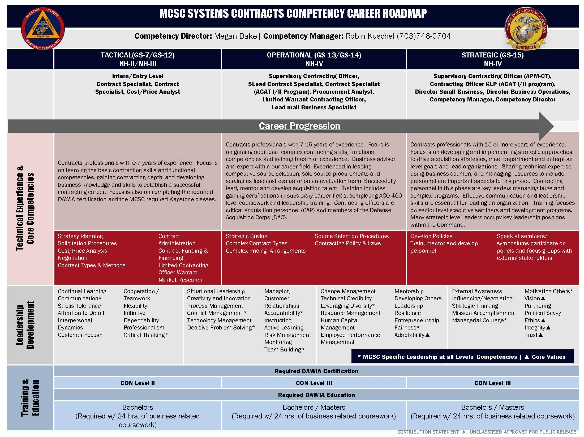
Contact Information

