Slide 1
A Career at Dahlgren
Les Greeley | anson.greeley@navy.mil
Daniel Mulyono | daniel.mulyono@navy.mil
Ryan Harris | ryan.harris2@navy.mil
Tiffany Lower | tiffany.lower@navy.mil
Megan Burgess | megan.burgess@navy.mil

Slide 2
Introduction
Name
Graduation Year
Major
Time at NSWCDD
Notes:
When I was a student, what would make a difference for me

Slide 3
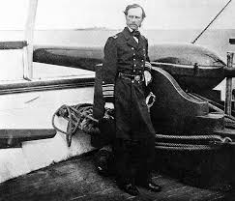
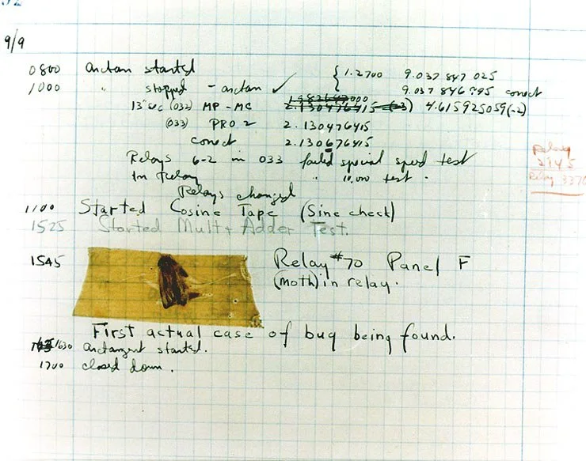
History
Founded in 1918 as the U.S. Naval Proving Ground
Known for: SLBM, Railgun, GPS and the first bug!
Distinguished figures that have worked for NSWCDD: Albert Einstein, Grace Hopper
Notes:
Add pic of Monterey – we did that
Tiffany

Slide 4
NSWCDD Departments
NSWCDD is one of six divisions of NSWC
NSWCDD contains 7 technical departments
Strategic & Computing Systems (A Dept)
Electromagnetic & Sensor Systems (B Dept)
Gun & Electric Weapon Systems (E Dept)
Weapons Control & Integration (H Dept)
Warfare Analysis & Digital Modeling (M Dept)
Readiness & Training Systems (R Dept)
Integrated Combat Systems (V Dept)
Conducts research in multiple scientific disciplines:
Physics, mathematics, laser, computer technology, software, mechanical, electrical and systems engineering, and biotechnology and chemistry.
NSWCDD is home to Naval Directed Energy Office.
AEGIS systems.

Slide 6
Requirements
Internships
3.0 GPA
Ability to obtain a security clearance
Full-time Positions
Bachelor's Degree in STEM
Ability to obtain a security clearance
Notes:
Add some pizazz to this
Check math requirement
Megan

Slide 7
Technical Rigor
Primary Languages
Java
C++
C
Python
Bash
Championing New Ideas
Containers
Databases
SQL & NoSQL
Cloud
Automation
DevOps
Kubernetes
Notes:
Ryan

Slide 8
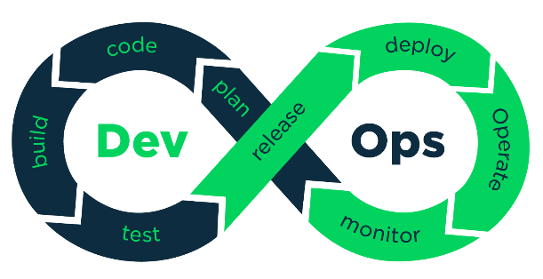
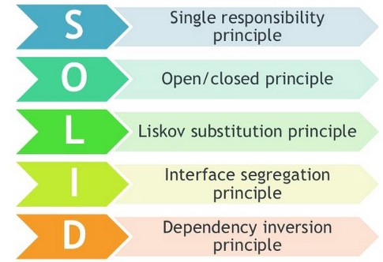
Technical Rigor
Using What You Learned In School
Agile software development
Design Patterns
Data Structures
Object Oriented Programming
Functional Programming
SOLLID principles
Teaching You Beyond School
Applying cutting-edge technology to real-world problems
Modernizing existing solutions
Solving large, complex problems
Balancing technical capability with people skills
Notes:
SOLLID – second L (least scope)
Ryan

Slide 9
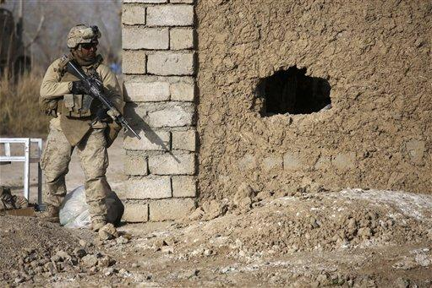
Imagination vs. Reality
Working with Others
Large Code Bases
Motivation to work
Politics/End Users
Phone Calls
Paperwork & Training
Internet
Never forget why you came to work today!!
Notes:
Daniel

Slide 10
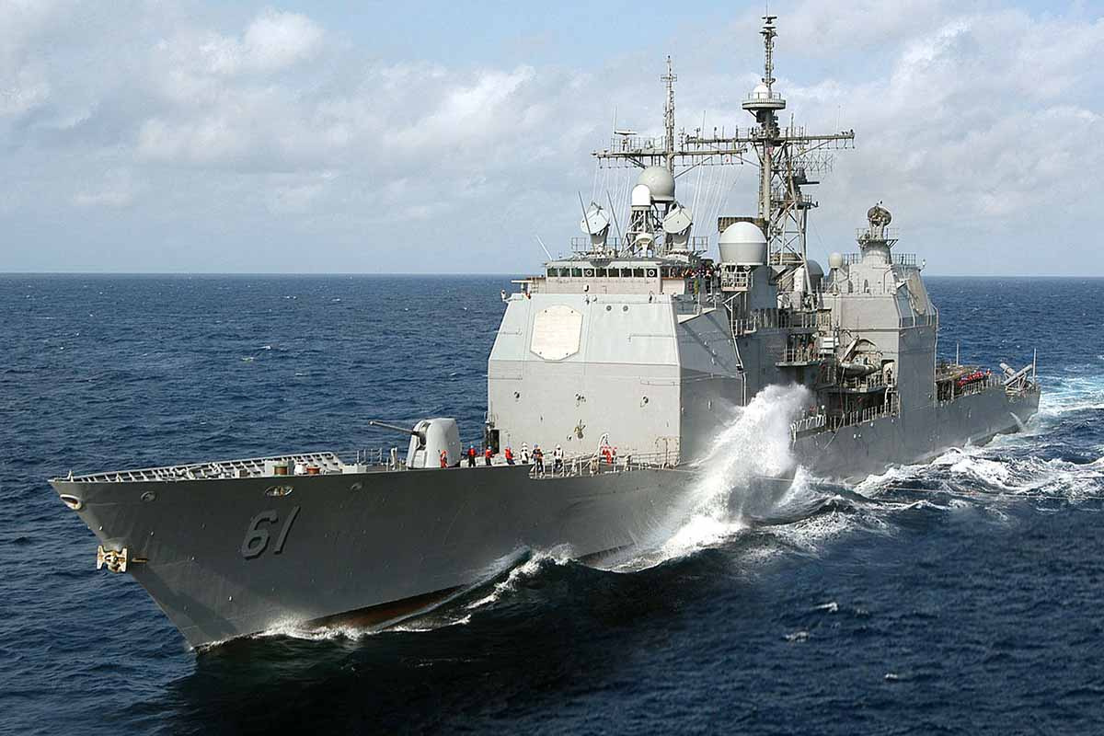
Full Time & Intern Employee Benefits
Rotations
Details
Competitive Pay
ND pay scale (performance based)
Retirement
Annual Leave
Credit Hours
Insurance
Paying for Higher Education
Tuition assistance for interns
Notes:
Interns only difference is pay
Les

Slide 11
Next Steps
How to apply
NSWCDD public site
https://www.navsea.navy.mil/Home/Warfare-Centers/NSWC-Dahlgren/Career-Opportunities/
What you will need
Transcript (Unofficial is fine)
Resume
When to apply
Anytime!
Clearances take some time (1-4 months)
Notes:
Public NSWCDD page
Email address
Need to include transcript – unofficial is fine
Les

Slide 12
Q/A
Les Greeley | anson.greeley@navy.mil
Daniel Mulyono | daniel.mulyono@navy.mil
Ryan Harris | ryan.harris2@navy.mil
Tiffany Lower | tiffany.lower@navy.mil
Megan Burgess | megan.burgess@navy.mil

Slide 13
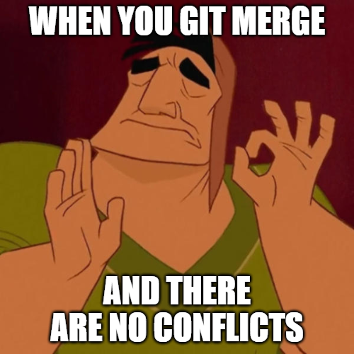
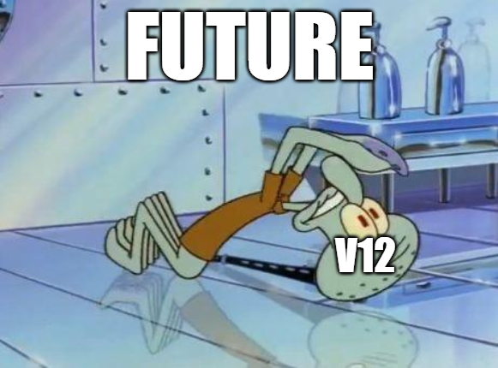
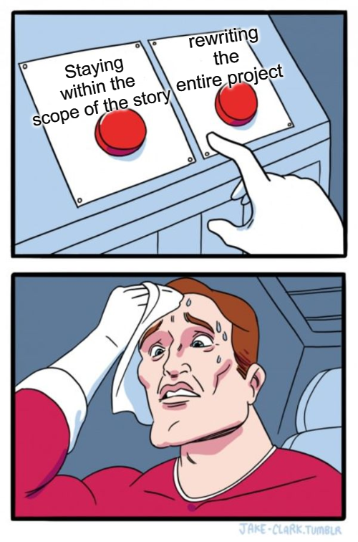
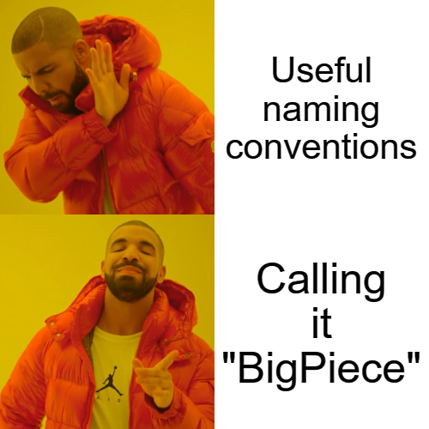
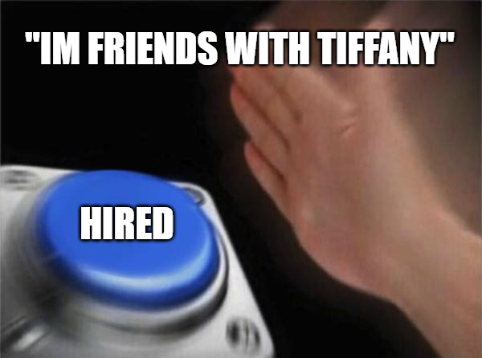
Notes:
New memes

