Slide 1
Empowering People with Special Needs Through Artistic Expression and Sensory Exploration

Slide 2
Presented By:
Jan P. Monroe, MS Ed CCC-SLP
Speech-Language Pathologist
Executive Director, STEP VA, Inc.
Commissioner, Virginia Commission for the Arts

Slide 3
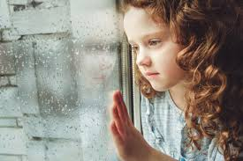
The Inspiration

Slide 5
WE ARE
WE DO
VOLUNTEERS
COMMUNITY PARTNERS
PEOPLE WITH SPECIAL NEEDS
PROFESSIONALS
SUMMER SESSIONS
SPECIAL EVENTS
COMMUNITY PARTICIPATION
CLASSES/WORKSHOPS
CONNECT GROUPS

Slide 6
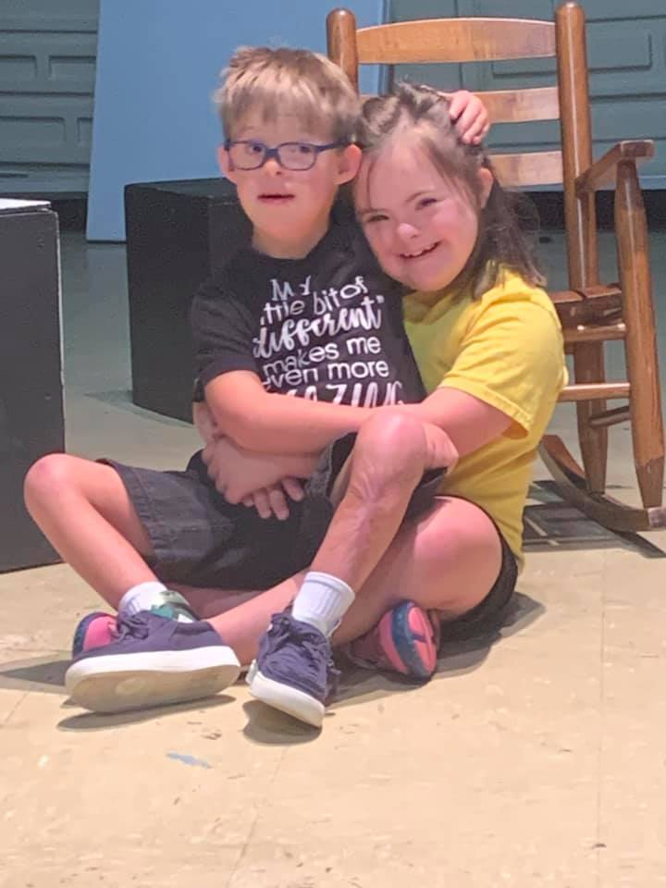
HOW WE ARE DIFFERENT
ARTISTIC EXPRESSION FOR INDIVIIDUALS WITH SPECIAL NEEDS
SENSORY EXPLORATION
MEET EACH INDIVIDUAL WHERE THEY ARE
CREATE NEW OPPORTUNITIES
PROMOTE SOCIAL INTERACTION
CELEBRATE ARTISTIC PROCESS
IMBEDDED MULTI-SENSORY EXPERIENCE
STRIVE FOR OPTIMAL SENSORY REGULATION
PROMOTE SELF AWARENESS/SELF CONFIDENCE –SENSORY NEEDS MET

Slide 7
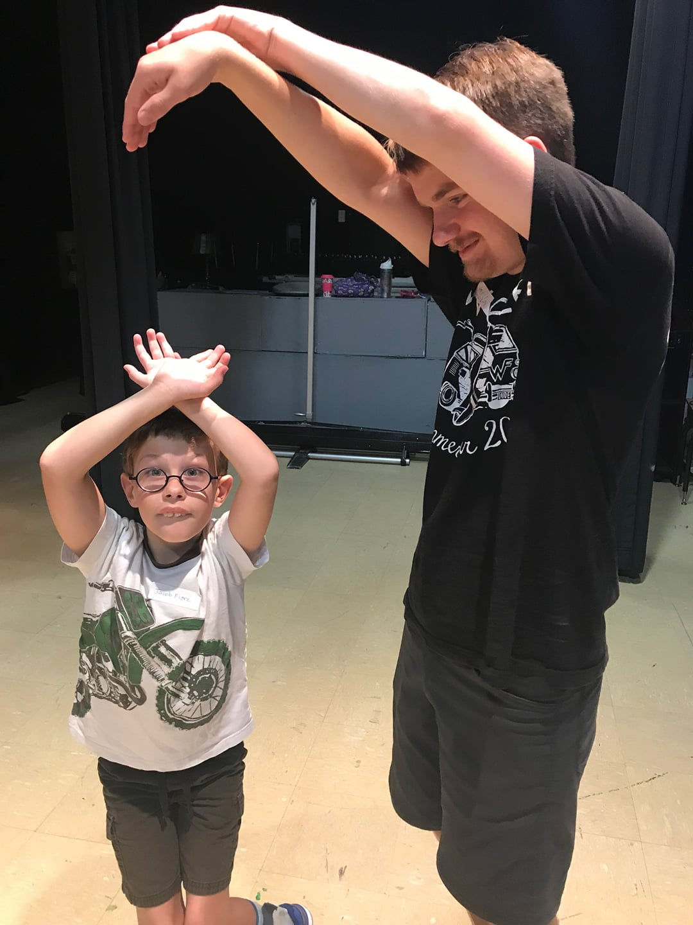
HOW IT WORKS
3 elements of sensory
Adaptations to the Environment
Embedded Sensory within Activities
Sensory Break Room
The Buddy System
2:1 or 1:1 Ratio Buddy with Participant
Model Activities
Provide Encouragement
STEP Program Opportunities
* Summer Sessions-15 hours per week
* Workshops- (2-4 hours) topic-specific by age
* Class Series- (4-8 week) Skill-based classes
* Connect Groups- (1-hour) Teen or Adult Social Time

Slide 8
THE NUMBERS
CDC & American Community Survey (ACS) Disability Rates
SINCE 2014 STEP VA HAS…
Served 112 children and adults with varying disabilities in our workshops, class series, and summer sessions, connect groups
Provided over 134 session slots for children aged 6-23 in our summer sessions
Established a 76% return rate for summer sessions
Promoted in Rappahannock region, Colonial Beach, and Northern Virginia Areas
Utilized over 127 volunteers through our volunteer orientation program gaining approximately 4182.25 volunteer hours
COUNTY % AGE WITH DISABILITY
FREDERICKSBURG CITY 9.2
KING GEORGE COUNTY 8.4
SPOTSYLVANIA COUNTY 12.9
STAFFORD COUNTY 8.5
Total US Population 11.5% (ACS)
Children and youth (ages 5-15) 5.4%. (ACS)
1 in every 54 children has a form of Autism (MAR 2020-CDC)

Slide 9
GROWTH POTENTIAL…
INFRASTRUCTURE SUPPORT
PROGRAM DEVELOPMENT
DESIGNATED SPACE
ADDITIONAL PROFESSIONAL STAFF
EXPANDED VOLUNTEER OPPORTUNITIES
PRESCHOOL WORKSHOPS
FOCUS TEEN/YOUNG ADULT GROUPS
VOCATIONAL SKILLS TRAINING

Slide 10
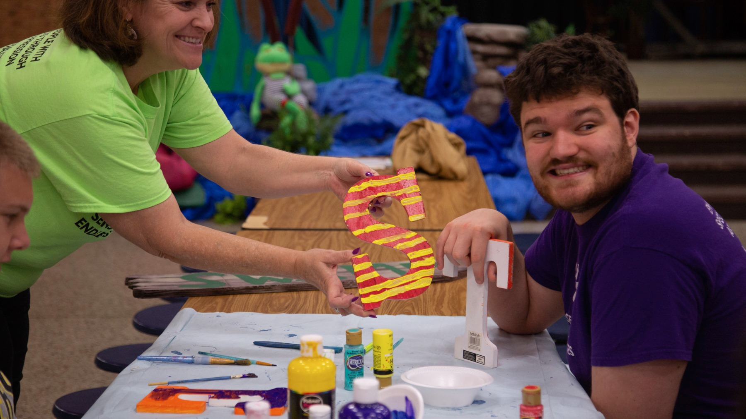
TECH CAMP

Slide 11
VOLUNTEERS MAKE IT HAPPEN
BASICS
BENEFITS
Must be age 13 or older
Complete an application
Attend basic orientation
Be available for scheduled session to be paired with a child
Welcomed as a support volunteer for any STEP VA sponsored activity
Receive Community Service Hours
Gain supervised, hands-on experience with people with disAbilities
Access to professions in the fields of OT, PT, Speech Pathology and Special Education

Slide 12
THE FIRST STEP…..
STEP VA, Inc. New Volunteer Application (google.com)
VIRTUAL VOLUNTEER ORIENTATION
FEBRUARY 27, 2021 10:00-11:30
Register to receive Zoom Link
ALL 13 AND UP ARE WELCOME

Slide 13
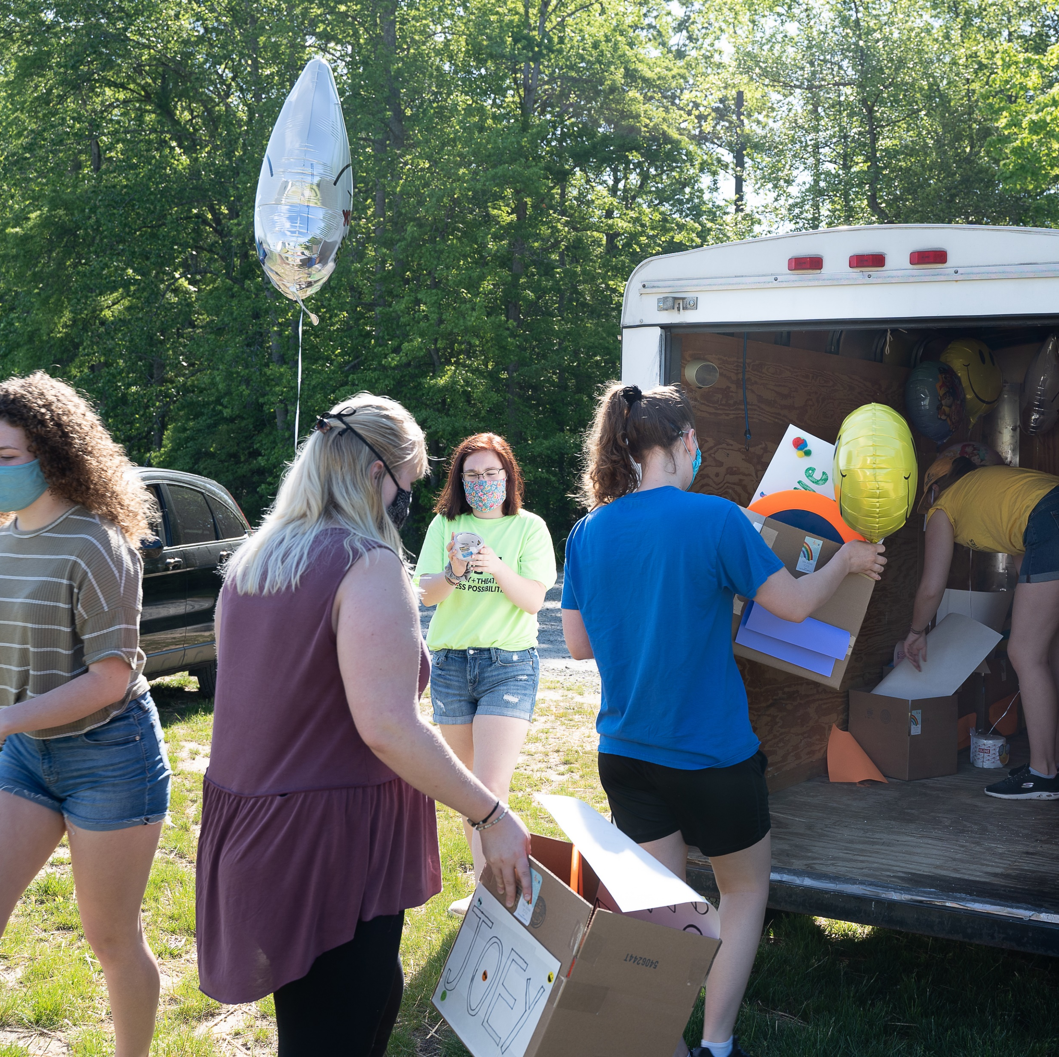
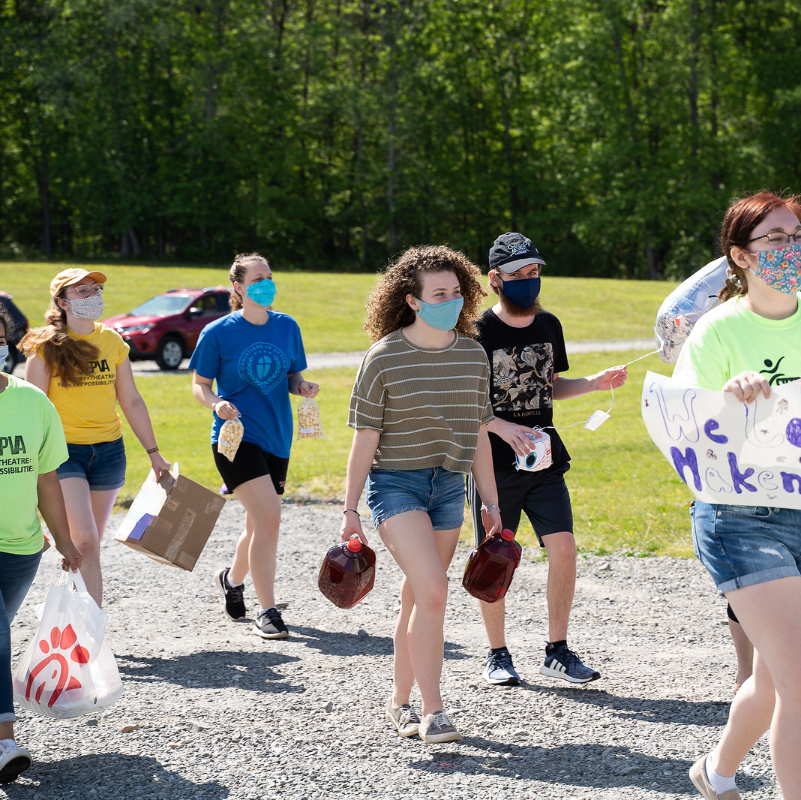
ON THE ROAD
OPERATION BOREDOM BUSTER

Slide 14
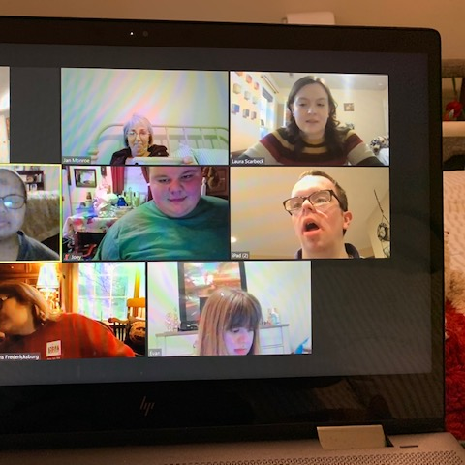
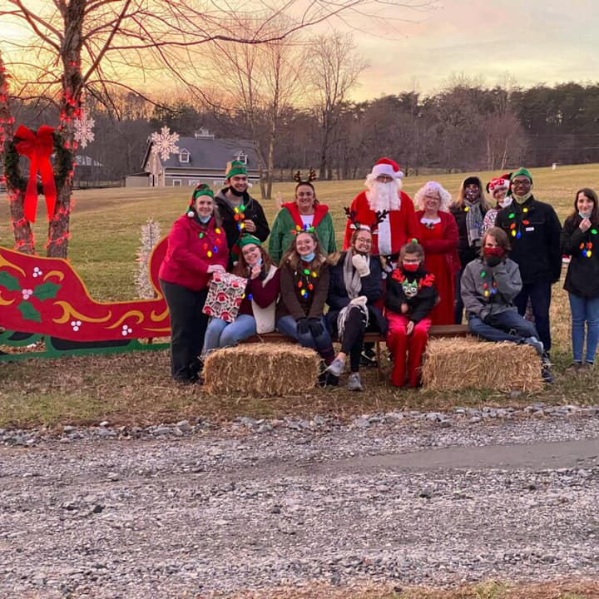
…In the Community
Adult connect group
Operation Santa Claus

Slide 15
COMMUNITY MATTERS PODCAST
Positive Hits PER Studio June 2019
A SPECIAL COVID 19
A Unique Surprise…..

Slide 16
P. O. BOX 42154
FREDERICSKBURG, VA 22404
757-535-1963
https://www.stepva.org
stepvainc@gmail.com

