Slide 1

Integrating Career Tools Into Your Courses
Michael Dunn – Director Mary Becelia – Assistant Director of Career Education
Center for Career and Professional Development
January 20 & 24, 2026

Slide 2
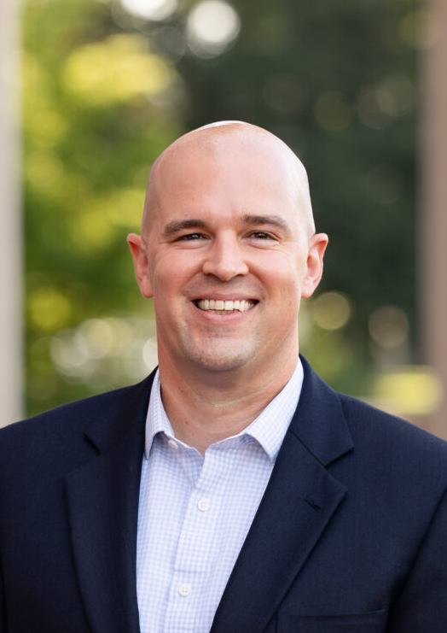
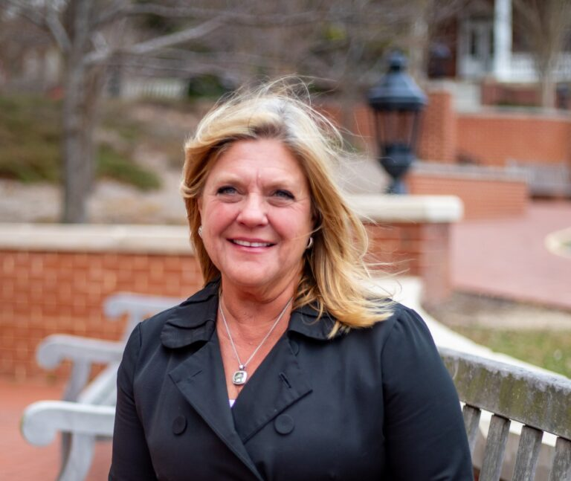

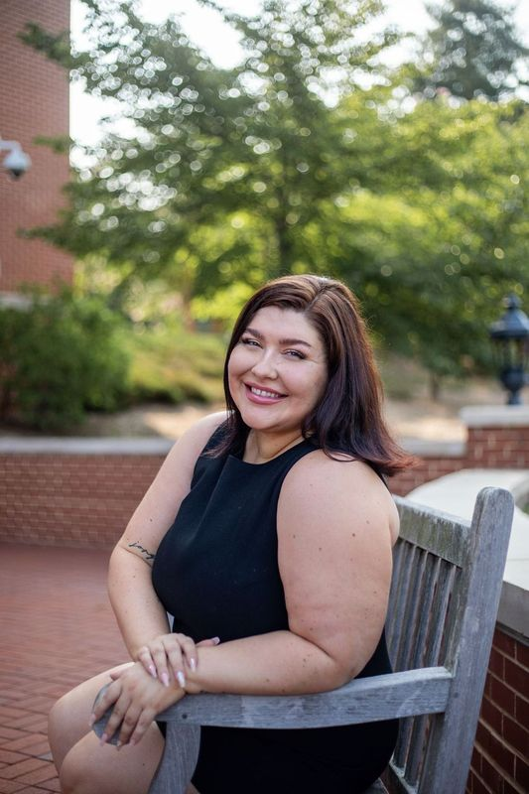

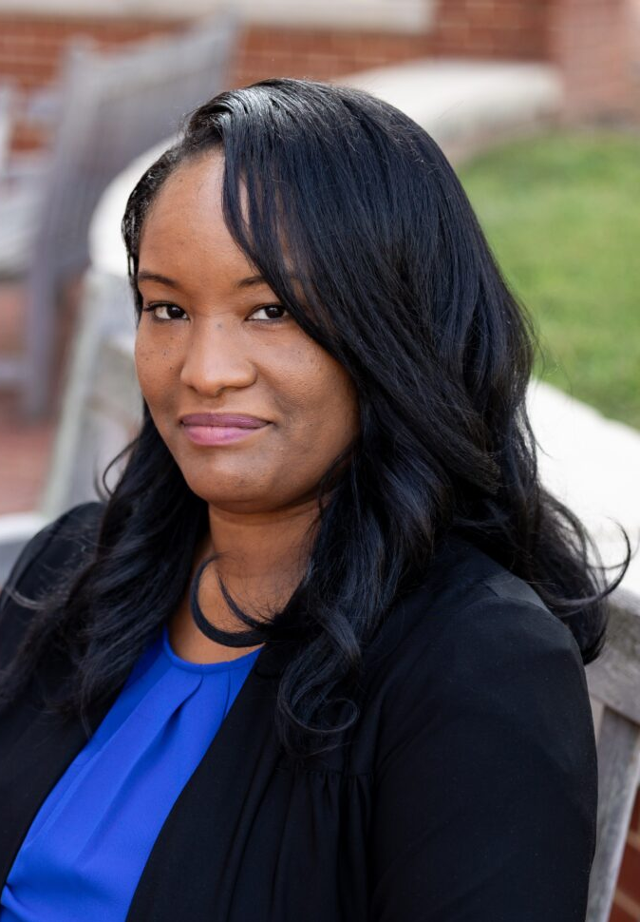
The CCPD Team
Michael Dunn | Linda Catullo | Mary Becelia | Emily Burke | Anika Rowe | Cherell Montgomery
Director | Associate Director of Employer Engagement | Assistant Director of Career Education | Student Experience Manager | Work-Based Learning Coordinator | Office Assistant

Slide 3


Slide 4
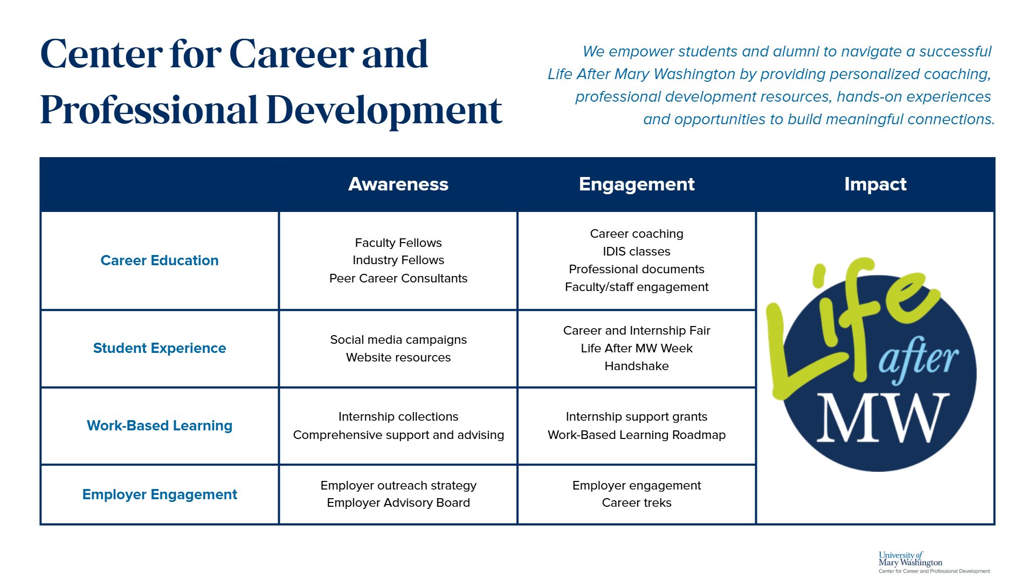

Slide 5
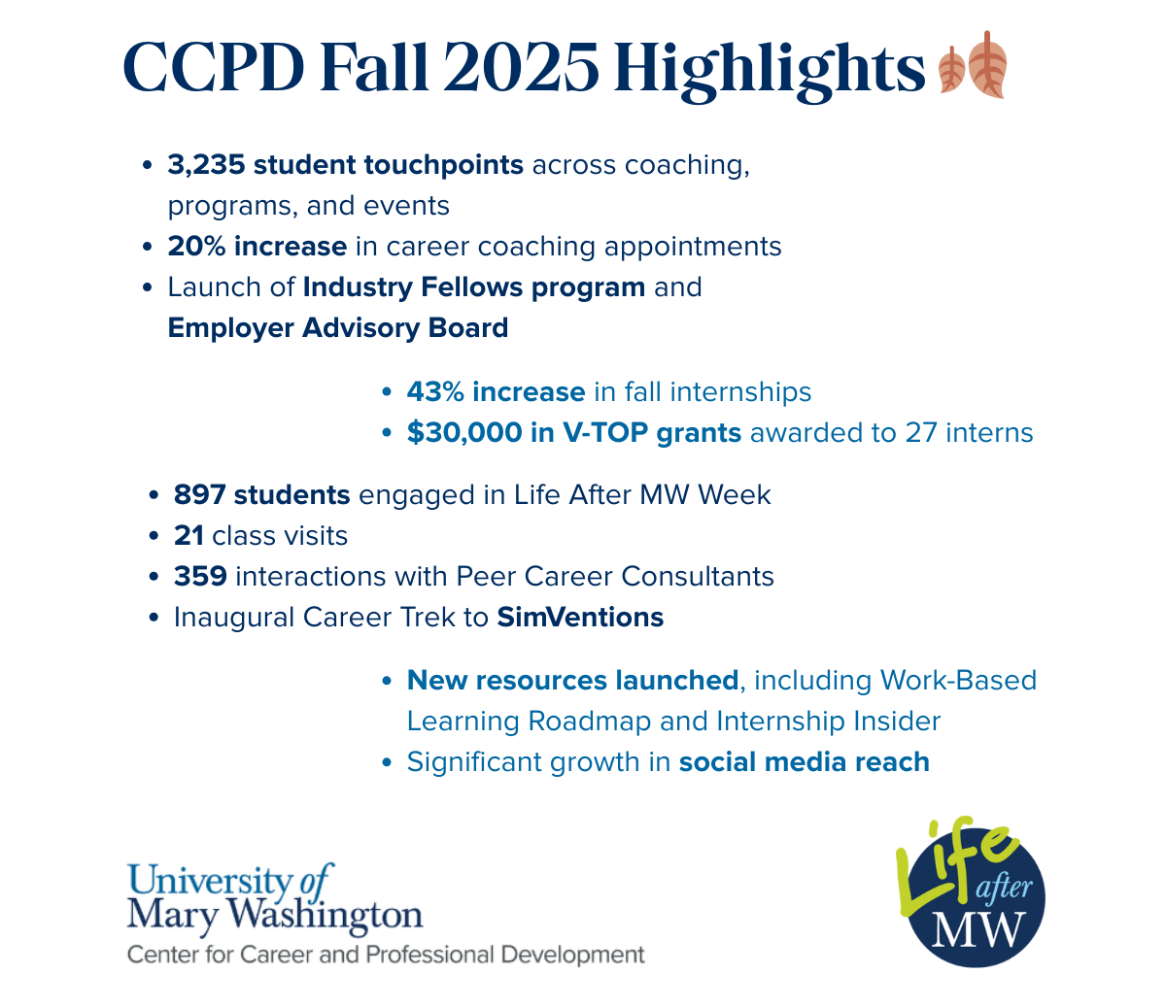

Slide 6
Let's talk career tools

Slide 7
Today's Goals
You'll walk away with a clear understanding of each tool’s purpose
You'll have some ideas of how to use these resources in your classes

Slide 8
Career Tools
Visit CCPD's Tools & Resources page
Big Interview - interview prep and practice with recorded feedback
FOCUS 2 - self-assessment of interests, values, skills, and goals
Forage - short, real-world job simulations designed by employers
Handshake - internship, job, and event searching
Network Mary Wash – alumni advice
Parker Dewey - paid, short-term micro-internships with organizations
Professional Document Support - resume, cover letter, LinkedIn, and professional communication guidance
Work-Based Learning Roadmap - resource to help students navigate campus opportunities

Slide 9

Big Interview
Develop an assignment for your class
View their submissions
Provide feedback
Students can also use on their own
MB

Slide 10

FOCUS 2
Self-assessment tool curated to UMW
Explore UMW majors and related careers
Develop action plans for academics and career
View and print reports
Useful starting point for AMW classes
MB

Slide 11

Forage
Free, virtual job simulations designed by top employers
Students complete real-world tasks tied to specific careers
No application or deadline; self-paced and flexible
Great for career exploration and skill-building
Completion certificates can be added to resumes and LinkedIn
MD

Slide 12

Handshake
Our primary career platform
Students can create and maintain profiles
Post and search for jobs, internships, and on-campus employment
Search events, career fairs, and workshops
Schedule career coaching appointments
Explore curated job collections by major, interest, geography, etc.
MD

Slide 13

Network Mary Wash
Connects students/grads seeking advice on careers-related matters with alumni working in the field
Useful resource for informational interview assignments
MB

Slide 14

Parker Dewey
Short-term, paid, professional micro-internships
Fully-remote projects, 5-40 hours
Ideal for students with limited availability or experience
Builds resumes, confidence, and real-world skills
Low-risk way for employers to engage students
MD

Slide 15
Professional Documents
Professional Document Resources
Resume writing tips/sample and a template
Cover letter writing tips and a sample
LinkedIn profile tips
Advice on developing references
Key take-away: Effective presentation
MB

Slide 16
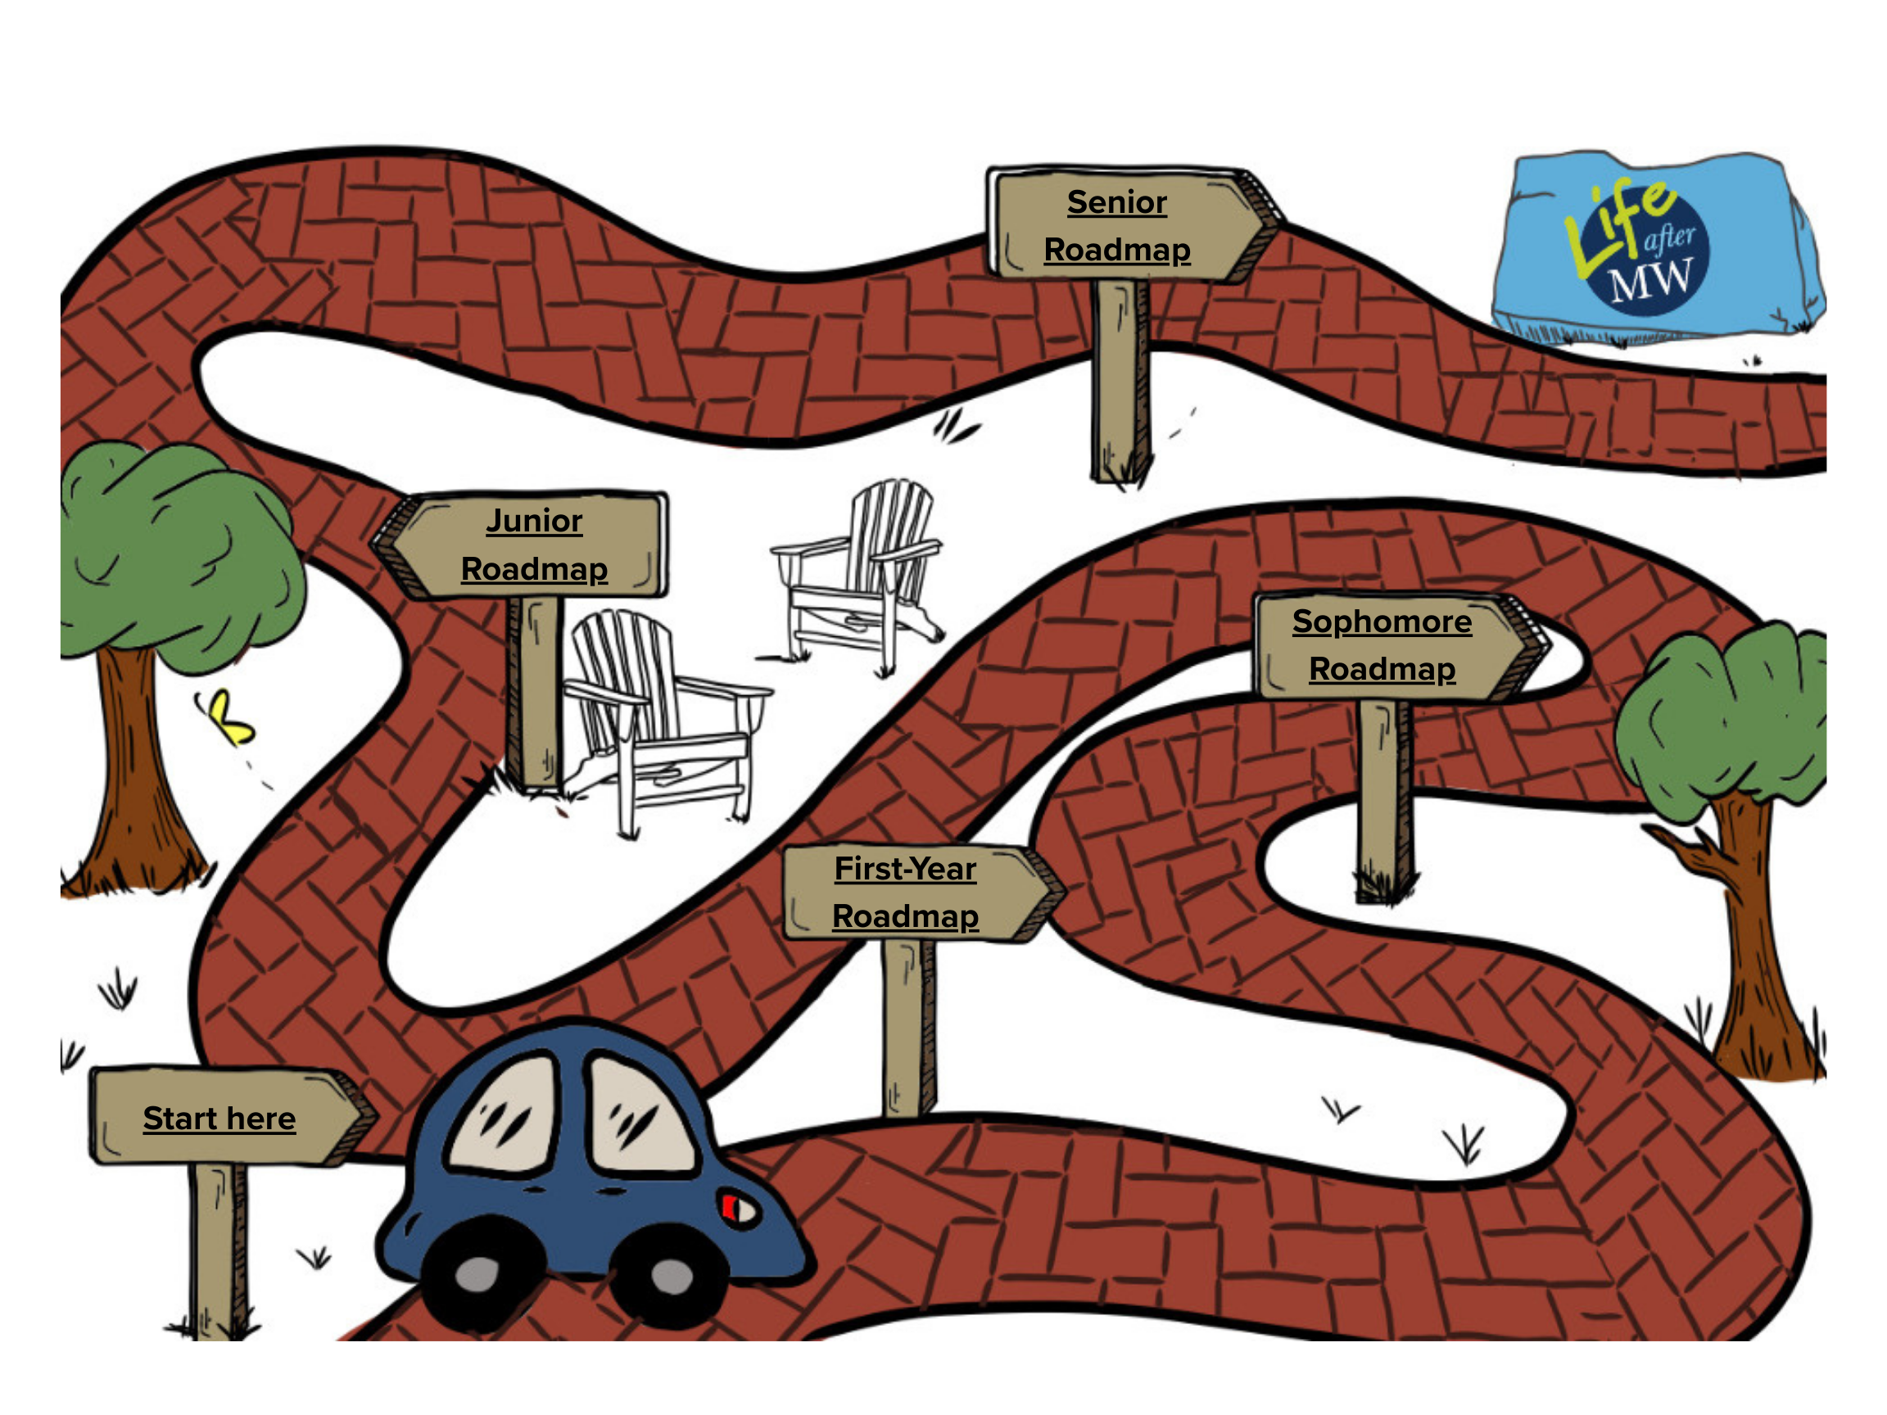
Work-Based Learning Roadmap
Self-paced Canvas resource highlighting on-campus work-based learning opportunities (such as job shadowing, internships, and apprenticeships)
Guides students through work-based experiences across their academic journey
Connects classroom learning to real-world application
MD

Slide 17
Using these resources

Slide 18
Quick Referral Guide
Student Says... | Refer Them To...
"I have no idea what I want to do." | Focus2, Forage
"I think I know my major, but not what jobs it leads to." | Focus2, Network MW
"I need experience, but don't have time for an internship." | Parker Dewey
"I'm ready to apply for jobs and internships." | Handshake
"I need help with my resume or cover letter." | Profl Doc Resources
"I have an interview coming up and I'm nervous." | Big Interview
"I want to talk to someone who's done this before." | Network MW
"How does this class connect to careers?" | WBL Roadmap
"What should I be doing now to be career-ready later?" | WBL Roadmap

Slide 19
Integrating Resources into Class
Faculty Goal or Scenario | Suggested Resource(s) & Use
Help students clarify interests or career direction | Focus2 for short assignment & reflection
Expose students to real-world work | Forage tied to course content or skill practice
Build experience for students | Parker Dewey as optional or extra credit
Support internship or job search readiness | Handshake demo & screenshot
Strengthen professional writing skills | Profl Doc Resources for resume/cover letter assignments
Prepare students for interviews or presentations | Big Interview practice & reflection
Connect coursework to alumni career paths | Network MW for informational interviews
Make career connections explicit in any course | WBL Roadmap to frame experiences & reflection

Slide 20
looking ahead

Slide 21
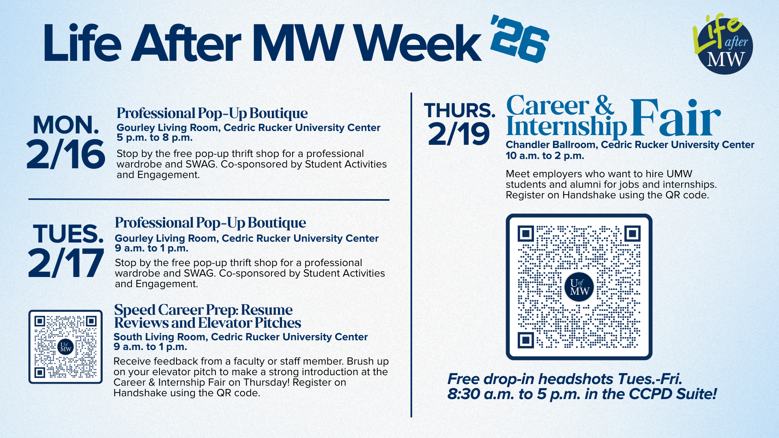

Slide 22
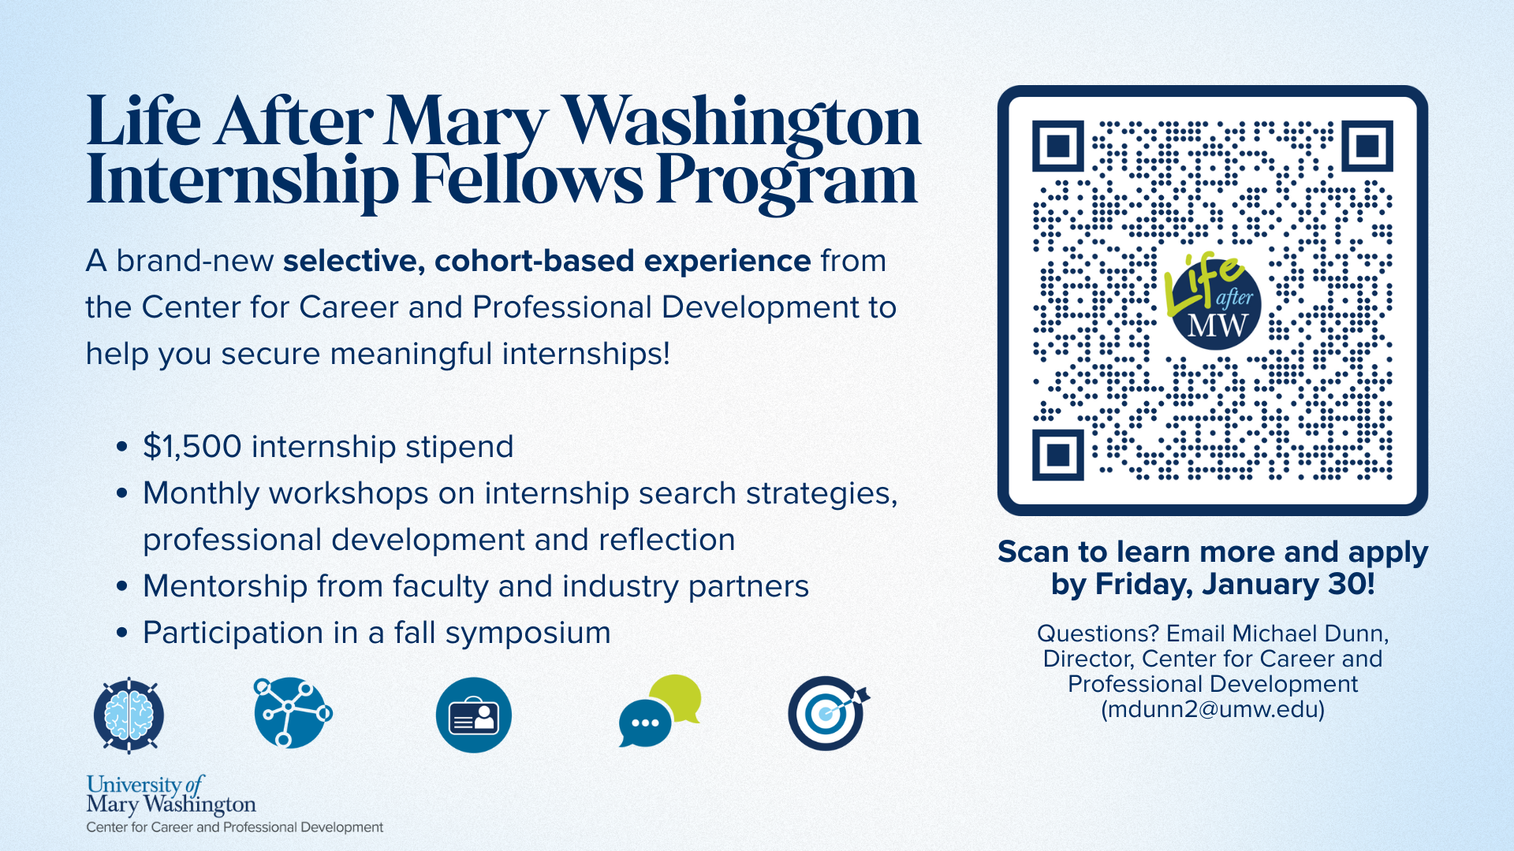

Slide 23

Thank You!
Michael Dunn
mdunn2@umw.edu
Mary Becelia
mbecelia@umw.edu
umw.edu/ careercenter

