Slide 1
Student Employment
Everything a Supervisor Needs to Know
Last updated October 2, 2015

Slide 2
Contents
Eligibility
Hiring Process
Additional Policies
MyTime
Dismissal
Summer Procedures
Looking Forward to 2016-2017
Feedback

Slide 3
Eligibility
Michael Jackson was inducted into the Rock and Roll Hall of Fame. It caused quite a controversy, because his nose isn't eligible for another fifteen years.
- Conan O'Brien

Slide 4
Eligibility for Student Employment
To be eligible for an on-campus job assignment, a student must be:
  In a degree-seeking program
  Enrolled at least half time (six credits)
  Have a minimum cumulative GPA of 2.00
  Have completed at least 70% of his or her attempted courses each semester

Slide 5
Loss of Eligibility
Students who fall below standards of eligibility are no longer authorized to work the following semester.
  EXCEPTION: If a student is employed during the fall term, and his or her CGPA falls to 1.65 – 1.99 after the fall term ends, then that student may continue to work in the spring. The student must bring his or her CGPA up to a 2.00 at the end of the spring term to maintain eligibility. The student is notified via e-mail of this “warning” period.
  If the student’s CGPA drops below 1.65, the student may not continue to work in the following spring term.

Slide 6
Hiring Process
I am convinced that nothing we do is more important than hiring and developing people. At the end of the day you bet on people, not on strategies.
- Larry Bossidy

Slide 7
Hiring Process
Carefully read this PowerPoint presentation and sign the Student Employment (SE) Supervisor’s Agreement
Understand and comply with AAEEOC recruitment and employment regulations
Review your departmental SE budget
Request SE applications from the Student Employment Coordinator by calling ext. 1685 or sending an e-mail to lneedham@umw.edu. Also consider stopping by the Office of Financial Aid to review a selection in person.
IF YOU HAVE YOUR OWN DEPARTMENTAL APPLICATION: contact the Student Employment Coordinator to ensure the student’s eligibility to work before proceeding with the hiring process

Slide 8
Hiring Process
Select and interview students
E-mail the Student Employment Coordinator with your assignment(s)
The Student Employment Coordinator will reach out to hired employees with required paperwork for campus employment
Wait until you receive a WORK AUTHORIZATION from the Student Employment Coordinator before allowing the student to work or train.
Conduct orientation with your student(s), explaining work expectations, assigned tasks, the use of MyTime, and any additional information required for their position.
Assignment notices to the Student Employment Coordinator must include:
  Student’s given name
  Student’s Banner ID
  Pay rate
  FOAP
  First day of work

Slide 9
Required Paperwork for Student Employees
New employees:
Application
Work Agreement
Confidentiality Agreement
VA Drug & Alcohol Policy
Form I-9
Original ID(s) for Form I-9
Form W-4
Form VA-4
Direct Deposit Form (must be accompanied with voided check or other third party documentation of account & routing number)
Returning employees:
Application
Work Agreement
Confidentiality Agreement
Optional:
Form W-4
Form VA-4
Direct Deposit form (must be accompanied with voided check or other third party documentation of account & routing number)

Slide 10
Form I-9
Federal Form I-9 policy indicates that an authorized official must E-Verify an employee’s eligibility to work in the United States within three days of his or her first day of work for pay.
It is the University’s institutional policy that student employees submit their paperwork, including IDs for Form I-9, on or before their first day of work.

Slide 11
Form I-9
Penalties for failing to comply with Form I-9 requirements range from $110 to $1,100 fines for each form.
If a student works without having submitted Form I-9 and IDs for the Form I-9, then we are not in compliance and could face civil fines.
Because we operate Federal Work Study, failure to comply with federal Form I-9 regulations could also result in the loss of our Title IV aid program.

Slide 12
Work Authorizations
A Work Authorization is a formal notice that a student employee is officially permitted to work by the Office of Financial Aid.
A student employee is only authorized to work or train when he or she has submitted every single required item to Financial Aid.
Under NO CIRCUMSTANCES does the Office of Financial Aid make any exceptions. “Extensions” and “placeholders” (i.e. a photocopy of an ID) do NOT exist.

Slide 13
Work Authorizations
Work authorizations are issued via e-mail to the supervisor at the end of the business day, or later in the evening during peak times of year.
If a student is working the same day that he or she submits paperwork, then the Office of Financial Aid will write up an authorization slip for the student to hand to the supervisor. The Student Employment Coordinator will later e-mail a formal authorization.

Slide 14
How To Expedite
Hire early, preferably around “break” periods. This will give the student employee enough time to gather his or her paperwork and IDs while at home.
Explain to the student during the interview process that the Office of Financial Aid needs to see original IDs if he or she has never worked for UMW before.
Direct student to Required Forms for Student Employment.

Slide 15
Additional Policies
Honesty is the best policy – when there is money in it.
- Mark Twain

Slide 16
No Study Policy
Students should not study, write papers, work on assignments or projects, leisure read, etc. while on the job.
Students need to learn how to prioritize and manage their time.

Slide 17
No Study Policy
With the extremely competitive job environment after graduation, now is an excellent opportunity to equip student employees with resume-building skills.
Student employees are state employees whose wages are being paid by YOUR tax dollars.
Use this time to engage and challenge your student employees to give them a valuable job experience.

Slide 18
Maximum Hours Per Week
When developing a work schedule for your student employees, consider both the student’s academic responsibilities and your departmental budget.
Formula for calculating one student’s wages for an academic year: (pay rate) x (hours per week) x 30 weeks
  Ex: $7.25 x 10 hours x 30 weeks = $2,175.
If you have students working over break periods, take additional working weeks and hours into account.

Slide 19
Maximum Hours Per Week
FCWS students must keep their average hours per week at 10 hours due to limited funding in the FCWS budget.
When scheduling an IWS student, aim for 10 hours per week or less. 12 hours may be a reasonable maximum for some students.
If you are thinking about hiring one student for 15 hours a week, consider hiring two students for 7 or 8 hours per week each.
Bottom line on hard caps: there is no true “hard cap” on hours per week for IWS beyond the 1500 hour state regulation, but you ARE limited to the student’s academic responsibilities and your departmental budget.

Slide 20
Pay Raises and FOAP Changes
Pay raises and department (FOAP) changes can only go into effect at the beginning of a pay period.
If you are working with two FOAPs, do NOT plan on having a student switch FOAPs in the middle of a pay period. This compromises the payroll process and increases the risk of error on a student’s pay.
Refer to the payroll calendar for pay period beginning and ending dates.

Slide 21
Stipends
Human Resources must approve stipend positions.
Complete an EWP and send it to Paula Wilder at pwilder@umw.edu.
If approved, contact the Student Employment Coordinator with the job assignment and a copy of the stipend contract.
Student employees’ stipends are paid biweekly in portions.
  Ex: $1000 stipend / 8 pay periods = $125 per pay period.
Students who are working under stipend contracts are still required to use MyTime. Students must clock at least 30 minutes per pay period to receive stipend.

Slide 22
Second Jobs
In the interest of our many applicants for on-campus employment, second job opportunities are limited to departments with extremely limited or unguaranteed hours (Academic & Career Services tutors, Peer Mentors) and to specific University outreach positions (Phonathon, TeleAmbassadors).
In certain circumstances, a student may also possess special and unique expertise that specifically qualifies him or her for an otherwise untrainable job.
The second job policy is under evaluation.

Slide 23
MyTime
The most fun is getting paid to learn things.
- Diane Sawyer

Slide 24
Payroll Schedule
Student employees are paid biweekly with expected paydays around every other Friday.
The student employee payroll schedule is located in the Student Employment section of the Financial Aid website under “Payroll Schedules and Information.”
The payroll calendar can also be found on the Payroll website under “Payroll Calendars.”
These calendars also include MyTime timecard approval deadlines.

Slide 25
Student Responsibilities
ALL student employees are responsible for clocking in and out of each shift.
  “Timestamp” users click “Record Timestamp” at the beginning and end of each shift.
  “Timecard” users enter the times worked directly into their timecards at the end of the day.
  Select departments use the “Card Swipe” function to clock hours.
Student employees are responsible for approving their timecards by noon every other Monday according to the payroll calendar.
  Best practice is for student employees to approve their timecards at the end of their last shift for the pay period.
Student employees should notify their supervisors immediately of any missed or incorrect punches.

Slide 26
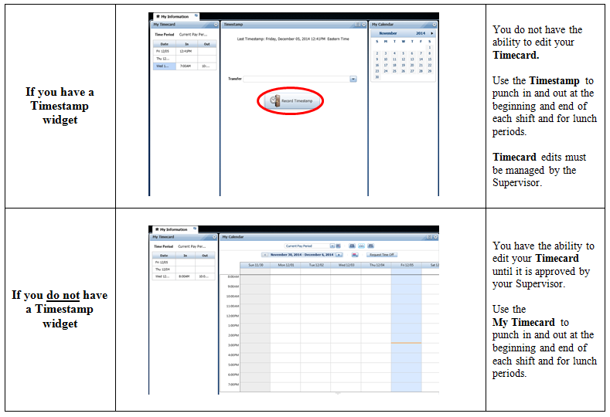
Timestamp vs. Timecard
(Student Employee MyTime manual, page 2)

Slide 27
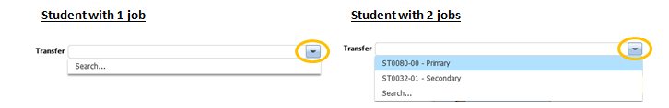
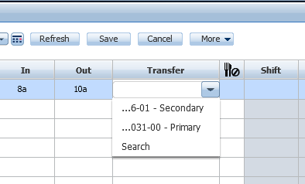
Students with Second Jobs
(Student Employee MyTime manual, pages 3 - 4)
Transfer Function for Timestamps (do NOT use to punch out):
Transfer Function for
Timecards:

Slide 28
MyTime Manual for Students
Provide a copy of the MyTime Manual for Student Employees to your student employees.
Download the manual at http://adminfinance.umw.edu/payroll/instructional-materials/

Slide 29
Supervisor Responsibilities
It is CRUCIAL that supervisors review the details of student employees’ timecards. Common mistakes:
  Outstanding or incorrect timecard punches
  Incorrect notation of AM and PM
  Incorrect FOAP
    Make sure student employees with two jobs know how to correctly clock hours for their jobs
    Contact the Student Employment Coordinator if you need clarification at lneedham@umw.edu.
Supervisors are responsible for approving their student employees’ timecards at the end of each pay period. Failure to do so holds up the entire student employee payroll.

Slide 30
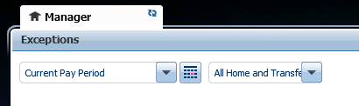
“All Home and Transferred-in*”
Students who have second jobs will not automatically appear under the Manager’s Tab for secondary job supervisors.
Secondary job supervisors need to select “All Home and Transferred-in*” to see their missing student employees.
This will only work if the
student employee has
clocked in to his or her
second job.

Slide 31
Budget Reports
Effective January 12, 2015, non-FCWS student employment wages are no longer included in the students’ financial aid award packages.
Former technical practices loaded wage accruals into the Departmental Pay Period Report; however, the Office of Financial Aid has lost this functionality since the policy transition.
Luckily, MyTime allows you to run your own reports.
Section XVIII of the MyTime Manual for Supervisors includes instructions for running reports on employee wage accruals.

Slide 32
MyTime Manual for Supervisors
Refer to the manual if you need help.
Download the manual at http://adminfinance.umw.edu/payroll/instructional-materials/

Slide 33
MyTime Troubleshooting
Make sure you are using Firefox to run MyTime.
Contact the UMW Help Desk at helpdesk@umw.edu or (540) 654-2255 if you are troubleshooting.
  Java issues
  Trouble logging on
  Employees missing or incorrect

Slide 34
Frequent Concerns
Student has trouble logging on…
  Does the student need a new password?
  Has the student been authorized to work?
Student can log on but cannot clock time…
  Did you or the student already approve the timecard for the current pay period?
Student is not showing up in the roster…
  Has the student been authorized to work?
  Are you the student’s secondary job supervisor?

Slide 35
Dismissal
The end of labor is to gain leisure.
- Aristotle

Slide 36
Dismissal
Students may be dismissed if they exhibit improper behavior, insufficient skills for the job, or do not report to work as scheduled without first contacting their supervisor.
Two incidents will result in a written warning, with a copy being sent to the Student Employment Coordinator, and a third incident may result in dismissal.
Students who are dismissed or voluntarily terminated will not be considered for another position on campus until the following semester.
The supervisor will complete a Notice of Cancellation, including the Separation Checklist, and submit to the Student Employment Coordinator immediately.

Slide 37
Evaluations
Complete a Service Rating for each student worker at the end of their job assignment each year.
Discuss this rating with the student and ask if he or she wishes to sign it.
Return copies of Service Ratings to Student Employment Coordinator, Lee Hall 230.

Slide 38
Terminations
The Office of Financial Aid will terminate all student employees who are not assigned a summer job at the end of the spring term, after May 1.
A Notice of Cancellation is not required for a student who completes the assigned job to the end of the term.

Slide 39
Preparing for the Upcoming Year
Complete and submit the memo sent in March/April to Student Employment Coordinator indicating which students are to be rehired for the upcoming academic year.
Inform the Student Employment Coordinator of all summer hires well before the beginning of the summer semester.

Slide 40
Summer Procedures
Ah, summer, what power you have to make us suffer and like it.
- Russell Baker

Slide 41
Summer Student Aides
Enrollment: summer student aides must have
been enrolled as students in the previous spring
term and registered for the upcoming fall term.
Summer enrollment is not necessary.
SAP requirements apply whether or not the student is enrolled.
Summer student aides are required to submit a summer application form to the Office of Financial Aid before receiving a work authorization.
Student aides may work up to 40 hours per week in the summer. Student aides will receive time-and-a-half compensation for time worked over 40 hours.

Slide 42
Summer Student Aides
Academic Departments will need to request summer funds from Dr. Morello thru Pam Taggert in Budget and Financial Analysis.
Hours worked prior to the middle of June will be paid from any remaining current fiscal year student employment budget.
Hours worked after mid-June will be paid from the upcoming FY student employment budget.

Slide 43
Summer Student Aides
Only students who are enrolled at least 6 credits in the summer are exempt from FICA.
The 6 credits may be distributed in any way between the summer sessions.
  6+ credits in May/June, <6 in June/July
  <6 credits in May/June, 6+ in June/July
  3+ in May/June, 3+ in June/July

Slide 44
Looking Forward to 2016-2017
If everyone is moving forward together, then success takes care of itself.
- Henry Ford

Slide 45
Upcoming Changes
Updated Student Employment Handbook (October 2015)
Online forms for the student employees (fall 2015) and supervisors (spring 2016)
Streamlined application process, to include job descriptions and starting pay rates (summer 2016)
Tighter deadlines for returning student employees
  Meaning if a returning student employee waits until the last minute to submit paperwork, the work authorization may not be issued that business day.
Annual supervisor training

Slide 46
Resources
MyTime Instruction Manuals
Payroll calendar (Payroll website)
Payroll calendar (Student Employment website)
Required Forms for Student Employees
Required Forms for Supervisors
AAEEOC recruitment and employment regulations

